Slide 1
Deep Learning Summit
San Francisco, Jan 2016

Slide 2
Outline
Background on Machine Learning
Conference Overview

Slide 3
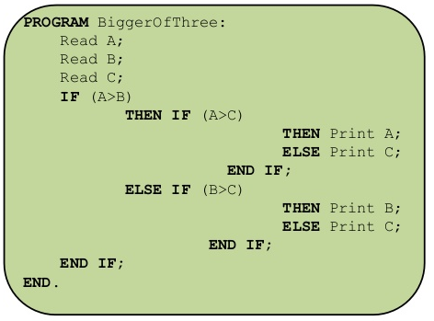
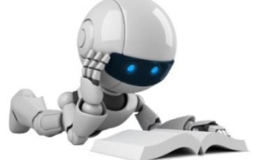
Introduction
Machine learning is the science of getting computers to act without being explicitly programmed.

Slide 4
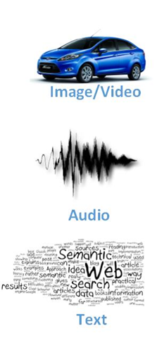
Introduction
Typical applications
Image recognition
Speech recognition
Web search

Slide 5
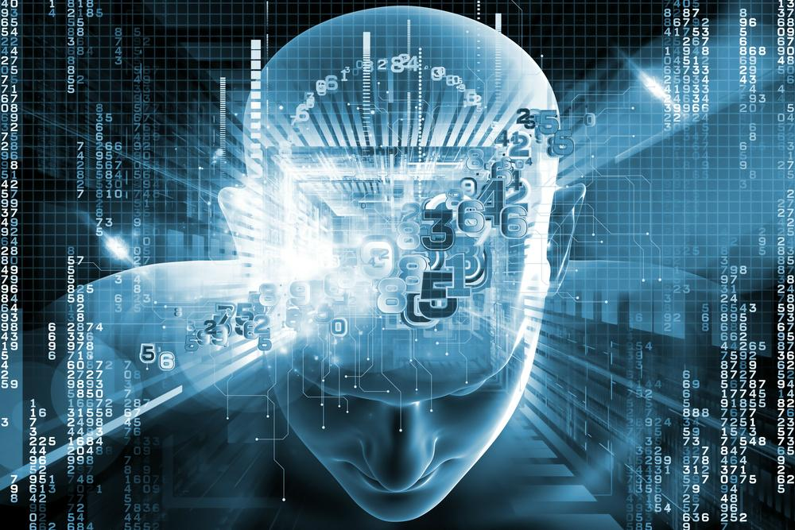
Introduction
History: Artificial Intelligence, 1956

Slide 6
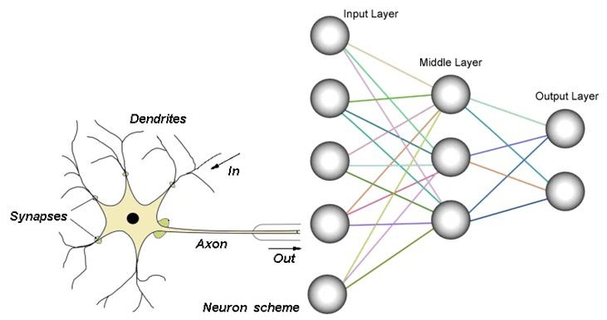
Introduction
Inspired by biology and human brain
Artificial Neural Networks, 1960

Slide 7
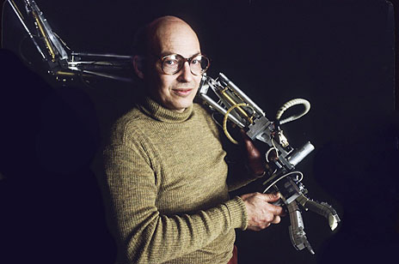
Introduction
Marvin Minsky, 1927-2016
“Within a generation, the problem of creating 'artificial intelligence' will substantially be solved.”

Slide 8
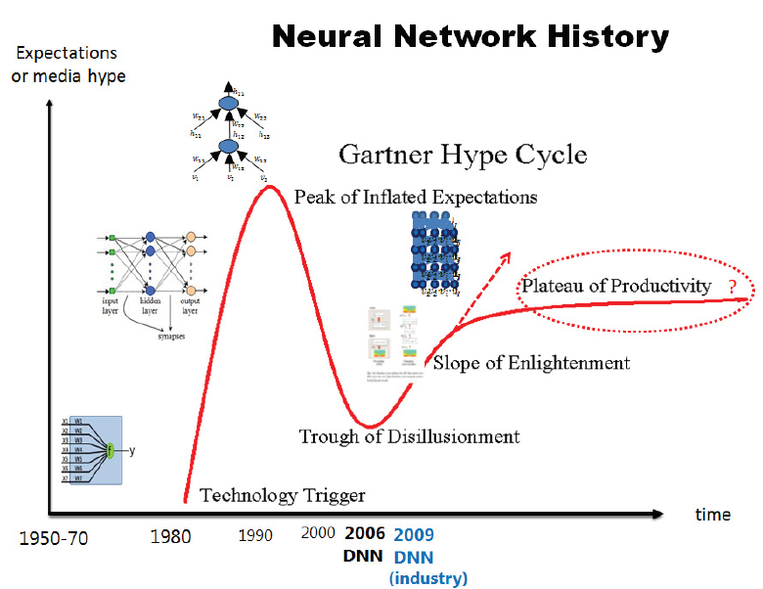
Introduction

Slide 9
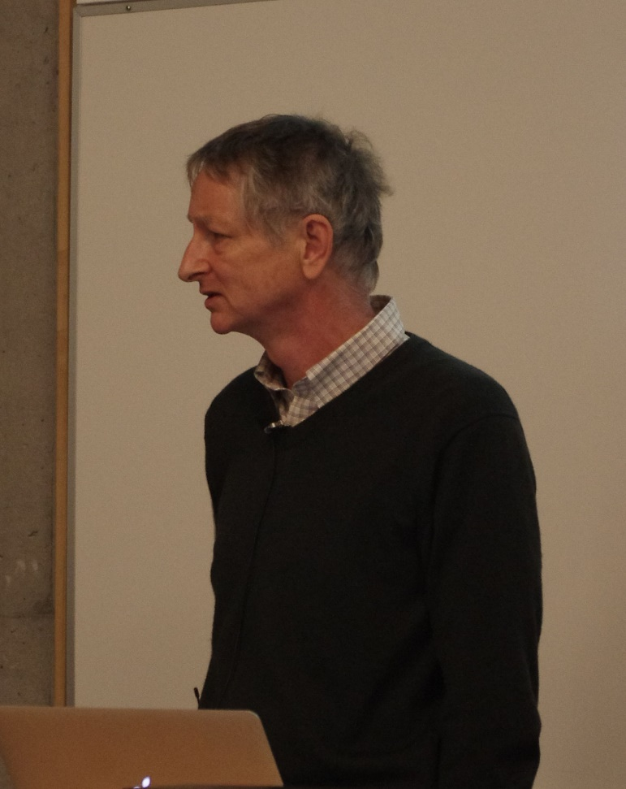
Introduction
Jeffrey Hinton, 2006

Slide 10
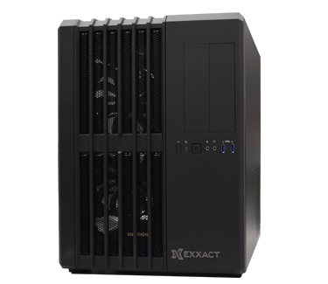
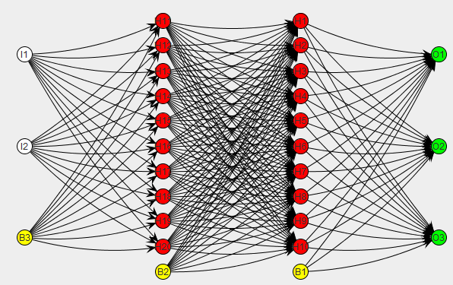
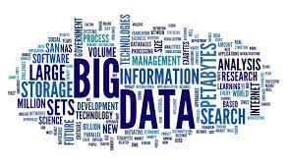
Introduction
Improvements since 2006
Better computers
Massive data
Better training methods

Slide 11
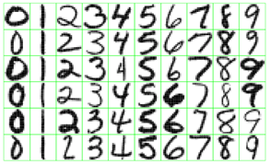
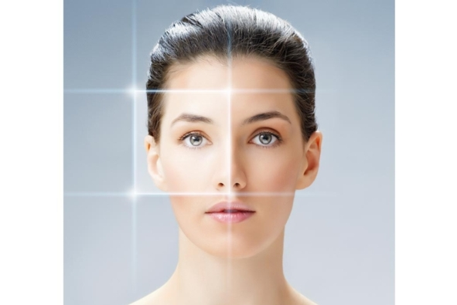
Deep Learning
Applications
Digit and Image recognition
Facebook, Google

Slide 12
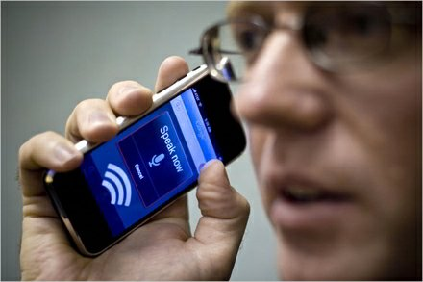
Deep Learning
Applications
Speech Recognition
Siri, Google, Microsoft real-time translation

Slide 13
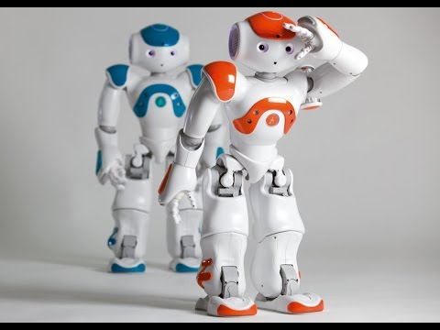
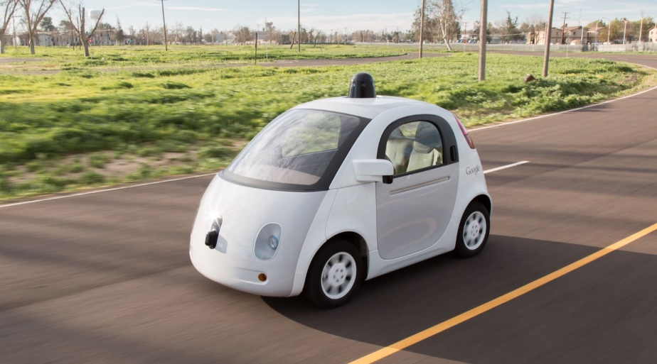
Deep Learning
Robotics
Self-driving cars

Slide 14
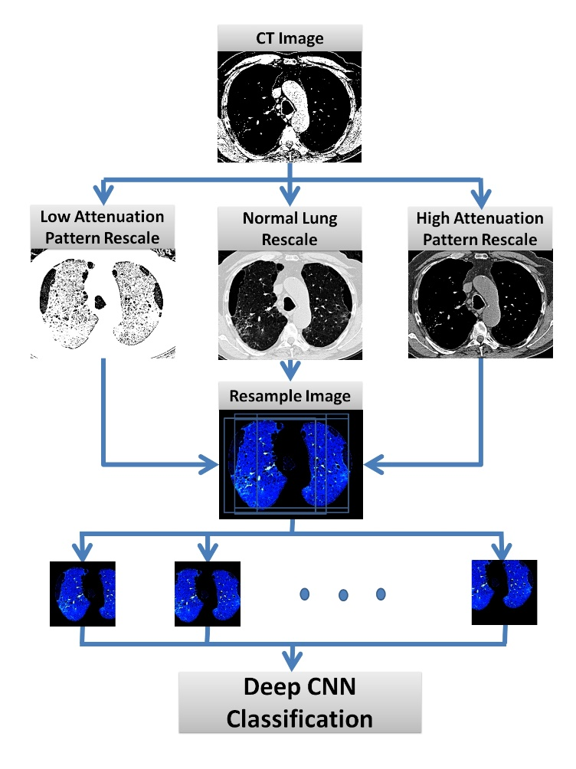
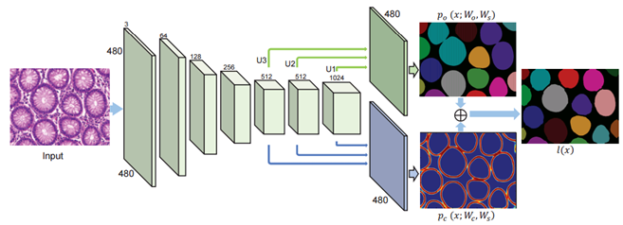
Deep Learning
Medical Imaging

Slide 15
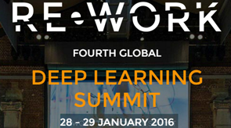
Deep Learning Summit 2016
A two-day conference
Talks from researchers and industry
Q&A with one of the leaders in the field

Slide 16
Industry
Large Companies
Pinterest, Twitter, eBay, Flickr
They use DL to be competitive
Small Companies
Baylabs, HealthMind: medical imaging
Satellite imaging analysis

Slide 17
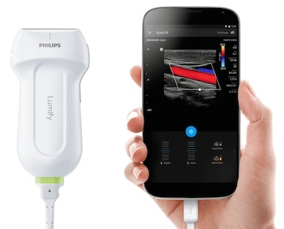
BayLabs: Medical Imaging
Increasing quality, value and access to medical imaging
Ultrasound: safe, effective and affordable
Smartphone ultrasound

Slide 18
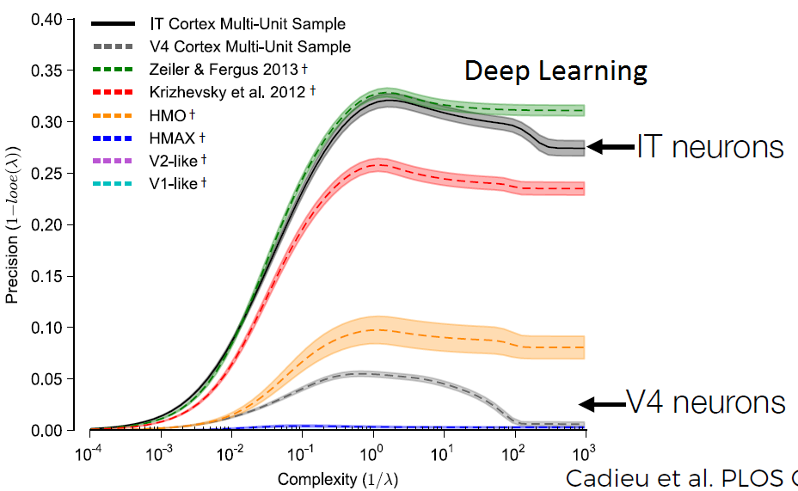
Expert Interpretation
Expert Ultrasound Interpretation Is Like Object Recognition “In-a-Glance”
Heart disease

Slide 19
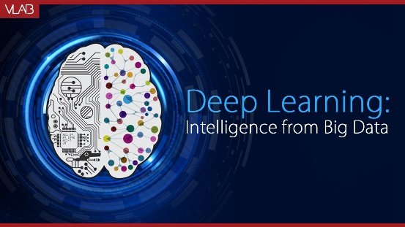
Deep Learning: Diagnosis
Deep learning algorithms are capable of detecting RHD in imagery from a portable ultrasound
Deploy deep learning technology in Rwanda

Slide 20
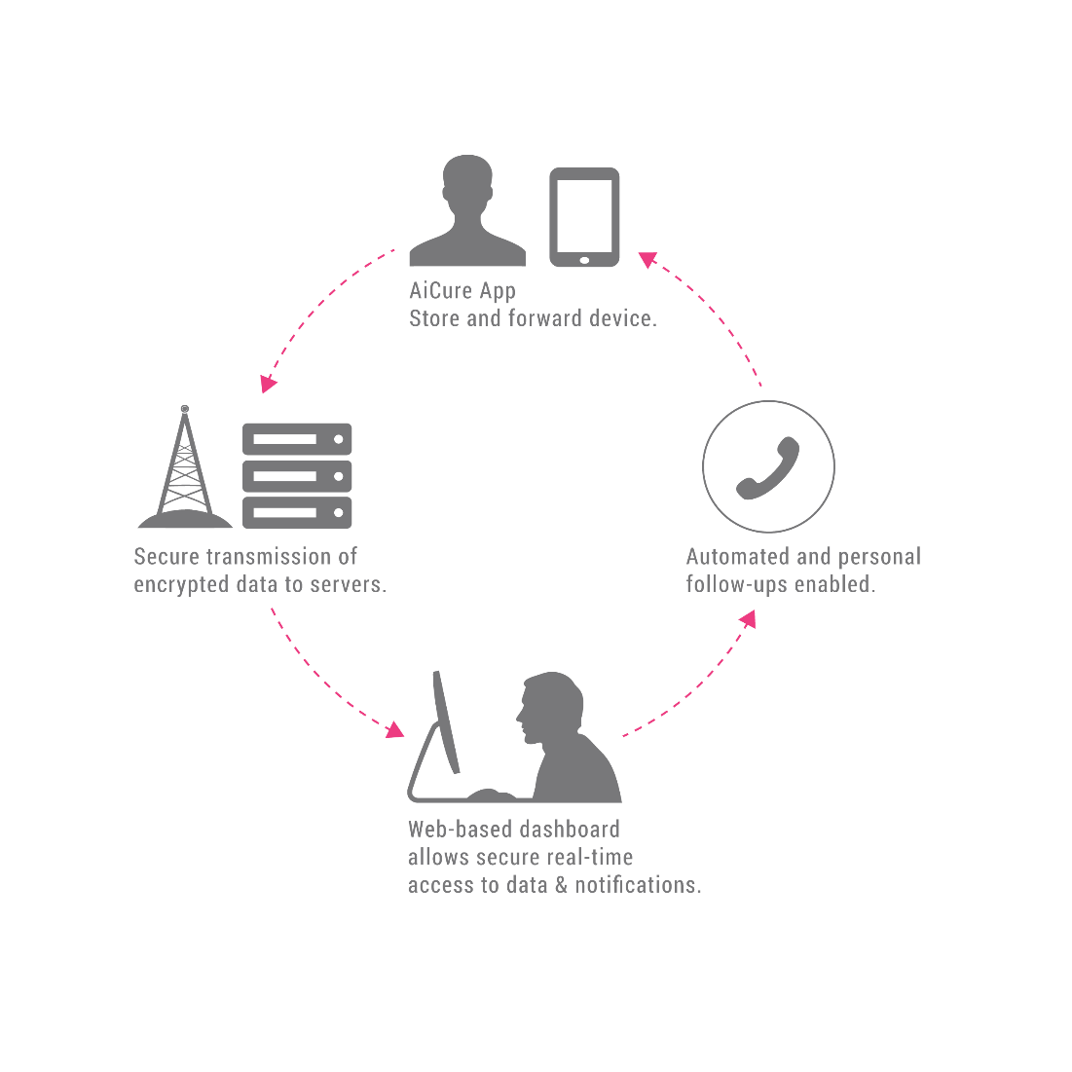
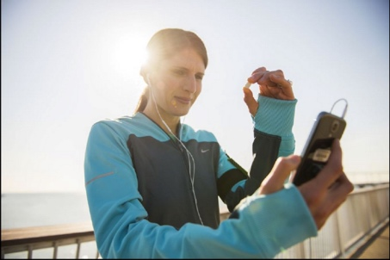
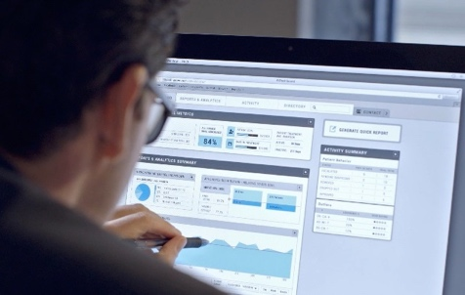
Deep Learning: Patient Monitoring

Slide 21
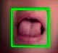


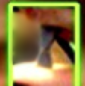
Deep Learning: Patient Monitoring
Control cheating

Slide 22
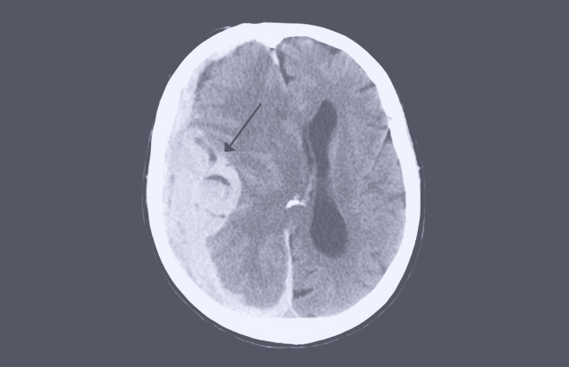
HealthMind: Medical Imaging
Intracranial Hemorrhage in CT images

Slide 23
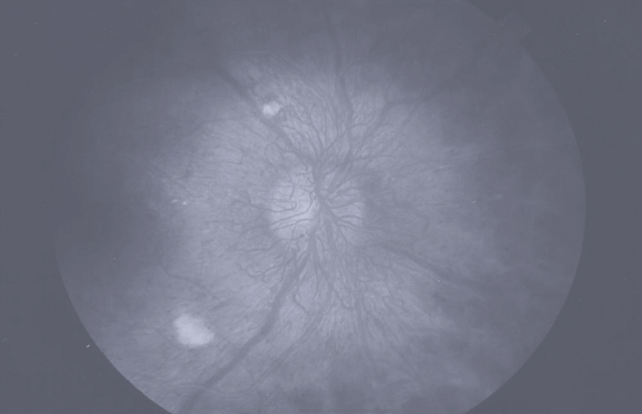
Medical Imaging
Diabetic Retinopathy in retinal images

Slide 24
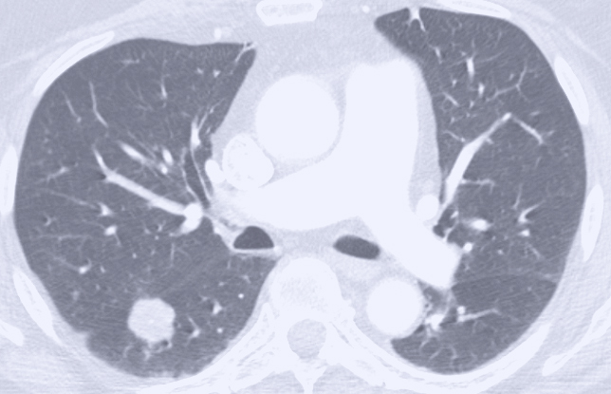
Medical Imaging
Lung Nodule on chest CT scan

Slide 25
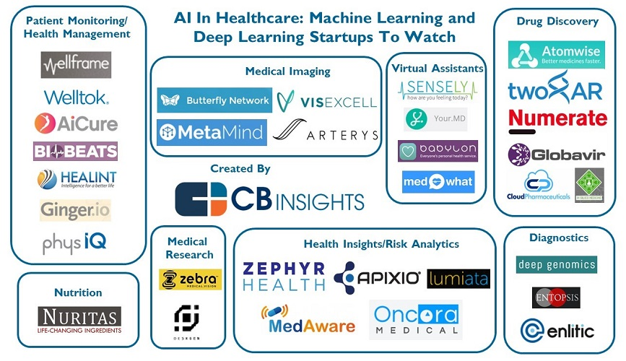
AI in Healthcare

Slide 26
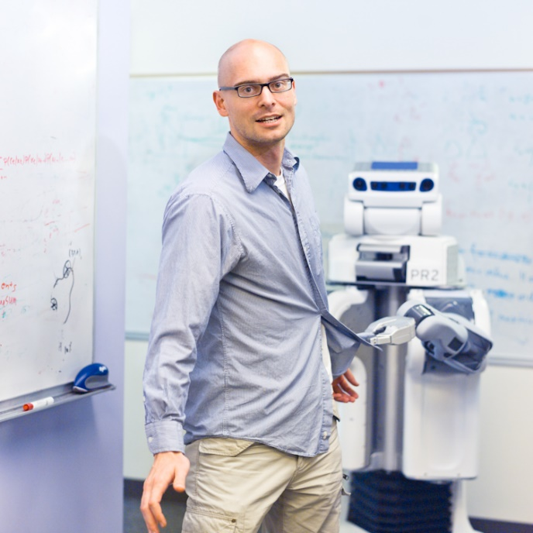
Robotics
Pieter Abbeel, UC Berkeley

Slide 27
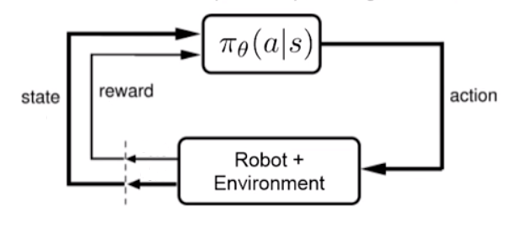
Robotics
Challenging

Slide 28
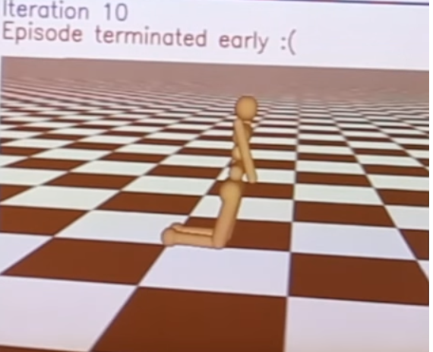
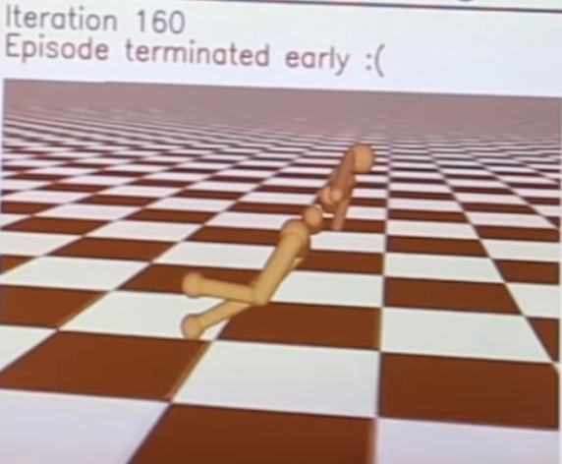
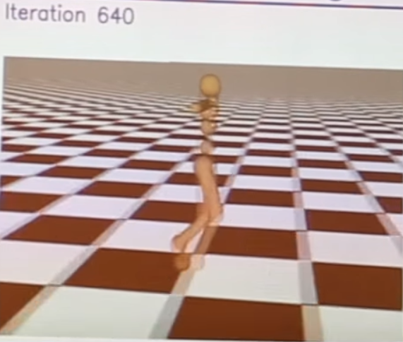
Robotics
Deep Reinforcement Learning: maximize Rewards
Robot invents walking

Slide 29
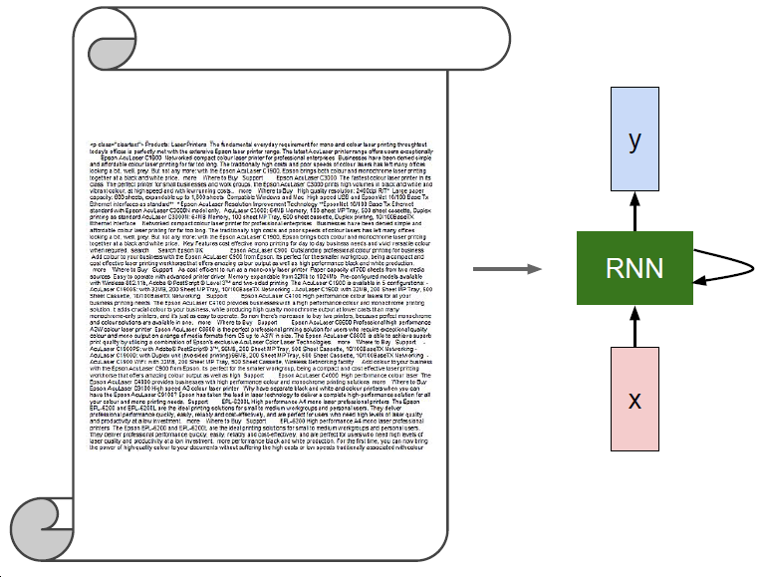
Recurrent Neural Networks
Example: Google search

Slide 30
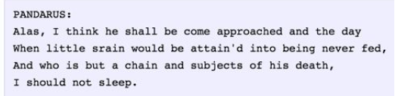
Computers generate poetry ☺

Slide 31
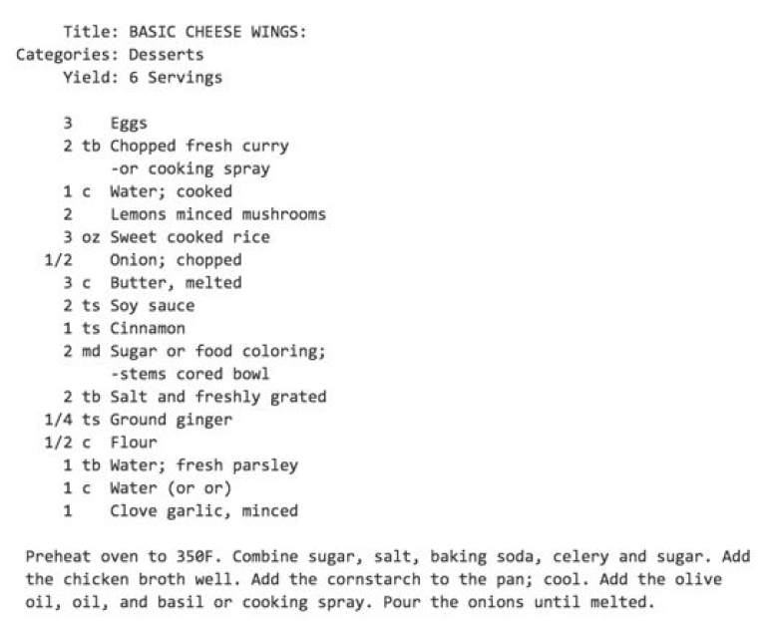
Computers generate cooking recipes

Slide 32
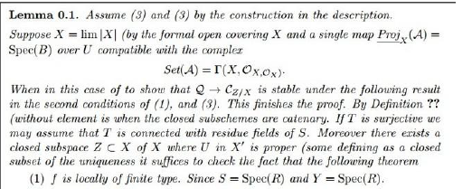
Computers generate math

Slide 33
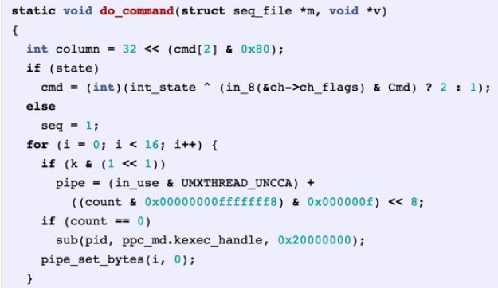
Computers generate C code

Slide 34
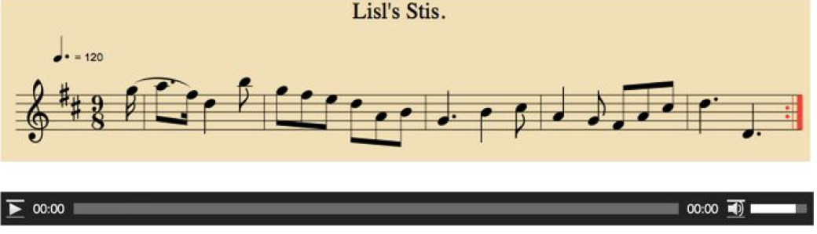
Composing Music
http://www.hexahedria.com/2015/08/03/composing-music-with-recurrent-neural-networks/

Slide 35
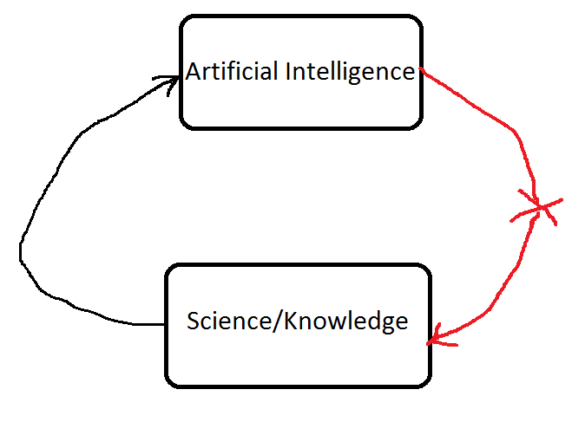
Future

Slide 36
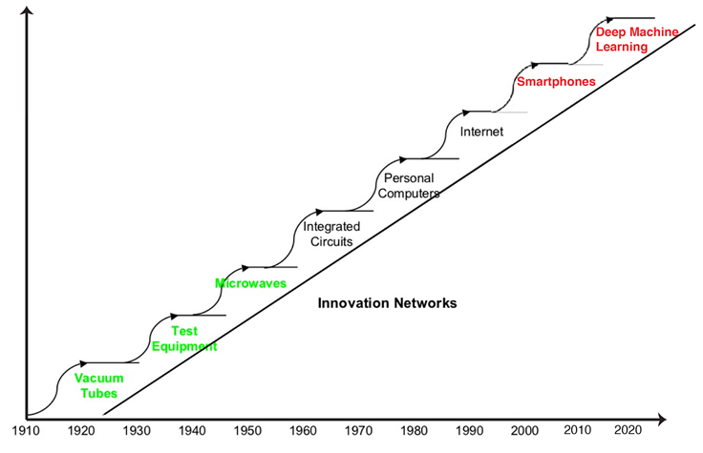
Technology Trend

Slide 37
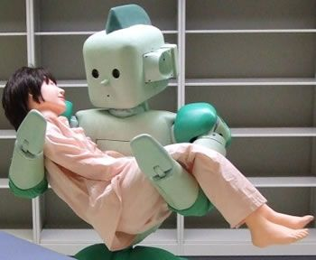
Summary
Portable medical imaging devices
Diagnostic machines with higher accuracy
Robotics for health
“By 2025, AI systems could be involved in everything from population health management, to digital avatars capable of answering specific patient queries,” said Harpreet Singh Buttar, an analyst at Frost & Sullivan.

Slide 38
Conferences
Overall
Good place to get exposed to the state-of-the-art AI technology for various applications
Future events: Deep learning in health care Summit
April 2016, London
Future events: Deep learning Summit
May 2016, Boston

Slide 39


